Slide 1
File System File System Implementation

Slide 2
Review
File System
Manages the information stored and hides the complexity on the storage devices
Provides the users access information in a convenient way and a uniform logical view
File
Abstraction, Object and Mechanism
Name, Path (absolute vs. relative), Structure, Type, Access, Attributes, Operations
Directory (Single level vs. Hierarchy)
Block & Characteristic special File

Slide 3
Objectives…
File System Implementation
File System Layout
Implementing Files
Implementing Directories
Shared Files
Log-Structured File Systems
Journaling File Systems
Virtual File Systems

Slide 4
File System Implementation
How files and directories are stored
How disk space is managed
How to make everything work efficiently and reliably

Slide 5
File System Implementation File System Layout
File Systems
Are stored on disks
Disks can be divided up into one or more partitions, with independent file systems on each partition
The 1st block in each partition is called boot block that exists even if the partition does not contain a bootable OS
The 2nd block is the super block
Contains the all key parameters about the file system including magic number (file system type), the number of blocks in the file system, and the other key administrative information
Is read into memory when the computer is booted or the file system is first touched
Next block is free blocks (ex: form of bitmap or a list of pointer)
The following block are i-nodes, an array data structures, one per file, telling all about the file
After that might come the root directory, which contains the top of the file system tree
Finally, the remainder contains all the other directories and files

Slide 6
File System Implementation File System Layout
File Systems (cont)
Sector 0 of the disk is called the Master Boot Record (MBR) that is used to boot the computer.
The end of the MBR contains the partition table
Gives the starting and ending addresses of each partition
One of the partitions in the table is marked as active
Mechanism of booted computer
The computer is booted, the BIOS reads in and executes the MBR
MBR locates the active partition, reads in its boot block and executes it
The program in boot block loads the OS contained in that partition

Slide 7
File System Implementation File System Layout
Tanenbaum, Fig. 4-9.

Slide 8
File System Implementation Implementing Files
Contiguous Allocation
Store each file as a contiguous run of disk blocks
Advantages
Simple to implement
Keeping track of files’ blocks needs
disk address of first block
the number of allocated blocks
High performance: get entire file from disk in one operation (only seek to first block)
Disadvantages
Fragmentation (internal and external)
Difficult to increase the file’s size

Slide 9
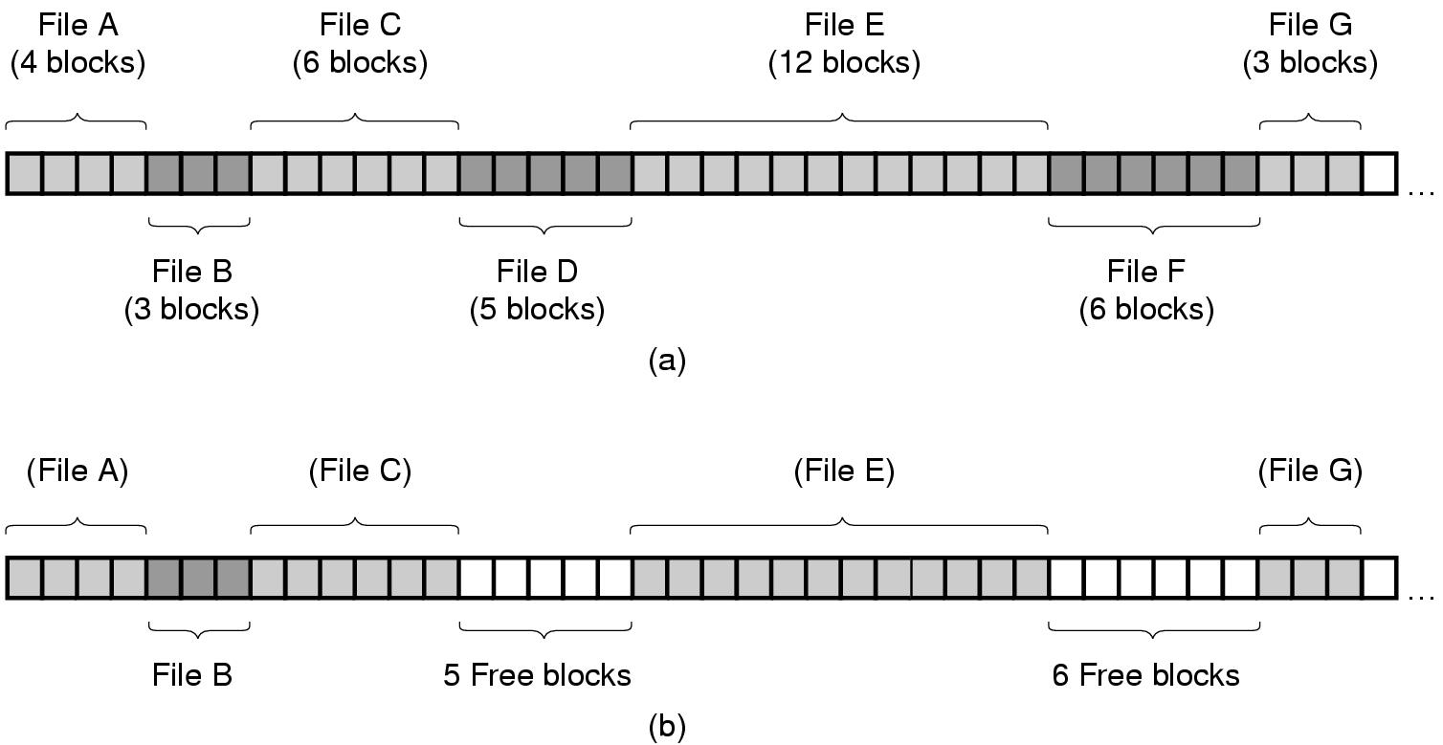
File System Implementation Implementing Files
Tanenbaum, Fig. 4-10.

Slide 10
File System Implementation Implementing Files
Linked List Allocation
Storing files is to keep each one as a linked list of disk blocks
First word of each block is used as pointer to the next one and the rest of the block is for data
Advantages
No external fragmentation (still internal fragmentation)
It is sufficient for the directory entry to merely store the disk address of the first block
Disadvantages
Random access is extremely slow
The amount of data storage in a block is not a power of two because the pointer takes up a few bytes

Slide 11
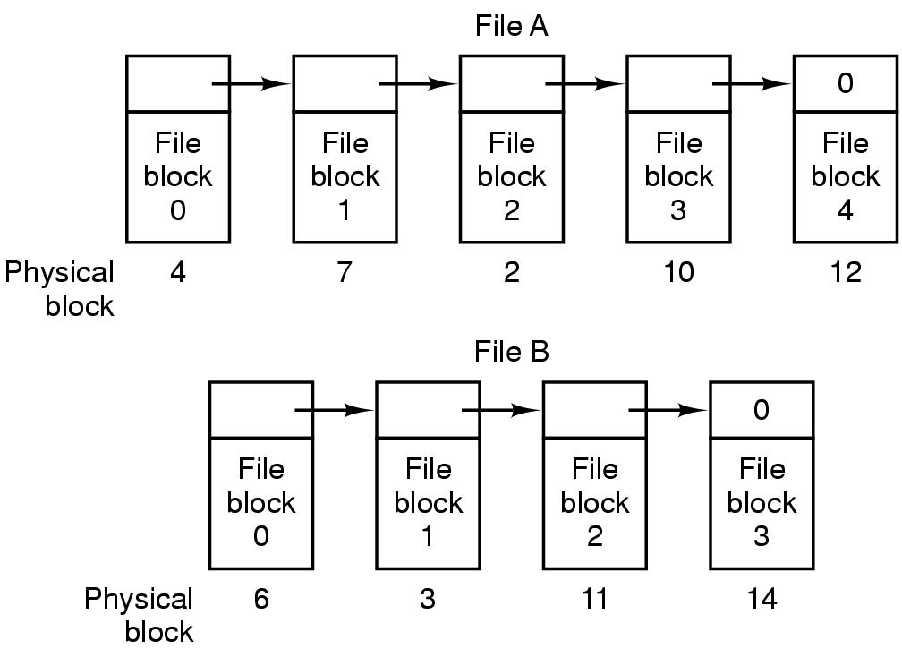
File System Implementation Implementing Files
Tanenbaum, Fig. 4-11.

Slide 12
File System Implementation Implementing Files
Linked List Allocation using a Table in Memory
Both the disadvantages of the linked list allocation can be eliminated by taking the pointer word from each disk block and putting it in a table in memory
(File Allocation Table – FAT)
Advantages
The same advantages as linked list allocation
The entire block is available for data
Random access is relatively fast
Disadvantages
The entire table must be kept for efficiency in memory
Ex: for a 200GB HDD, 1KB Block-size, 4 bytes for an entry → 200 mil. entries → 600MB – 800MB of memory for FAT
Not wildly practical and does not scale well to large disks

Slide 13
File System Implementation Implementing Files
Tanenbaum, Fig. 4-12.

Slide 14
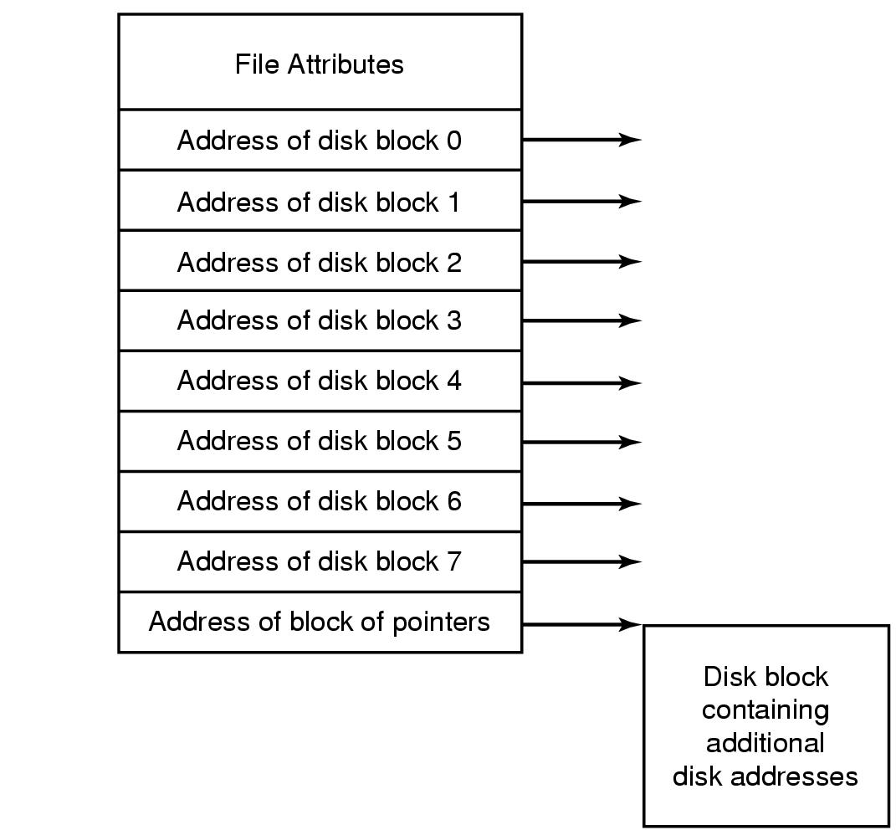
File System Implementation i-nodes
Is briefcase of index-nodes
A data structure (involve 2 parts) associates with every file
Part 1: Lists the attributes
Part 2: Disk addresses of the file’s block. It divides 2 sub parts
Sub part 1: contain the address of disk block i^{th} in directly
Sub part 2: contain the address of block of pointers that is used with large file (multilevel index)
Given the i-node, it is then possible to find all the blocks of the file
Tanenbaum, Fig. 4-13.

Slide 15
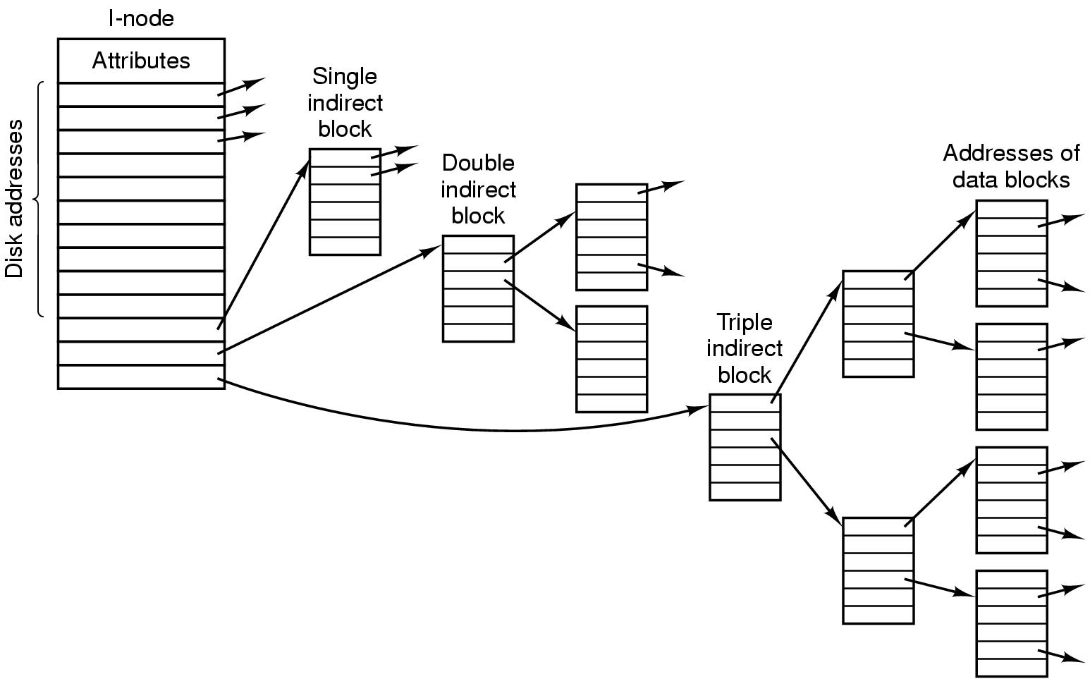
File System Implementation i-nodes – Example

Slide 16
File System Implementation i-nodes
Advantages
The space is reserved because i-node need only be in memory when the corresponding file is open
Allows the maximum number files that may be opened at once
Is smaller than the space occupied by the file table
Disadvantages
Each i-nodes has room for a fixed number of disk addresses (not flexibility) → reserve the last disk not for data block, but it is used to contains more disk block address
Ex: An i-nodes has contain 10 direct addresses and 1 single indirected addresses of 4 bytes each and all disk blocks are 1KB. What is the largest possible file?
10 direct address with 1KB each block: 10 * 1KB = 10KB
1 single indirected address
Size 1KB = 1024 byte
The pointer is 4 byte → 1024/4 = 256 pointer can point 256 block address with 1K
→ 256 * 1KB = 256KB
→ The largest possible file is 10 + 256 = 266 KB

Slide 17
File System Implementation Implementing Directories
The main function of the directory system is to map the ASCII name of a file onto the information needed to locate the data of that file
When a file is opened, the OS used the path name to locate the directory entry that contains
The information needed to find the disk blocked such as disk address of entire file, or the number of the first block, or the number of the i-node
Some file attributes
In simple design, a directory consists of
A list of fixed size entries, one per file, containing a (fixed-length) file name, structure of the file attributes, and one or more disk addresses
Or just a file name and i-node number

Slide 18
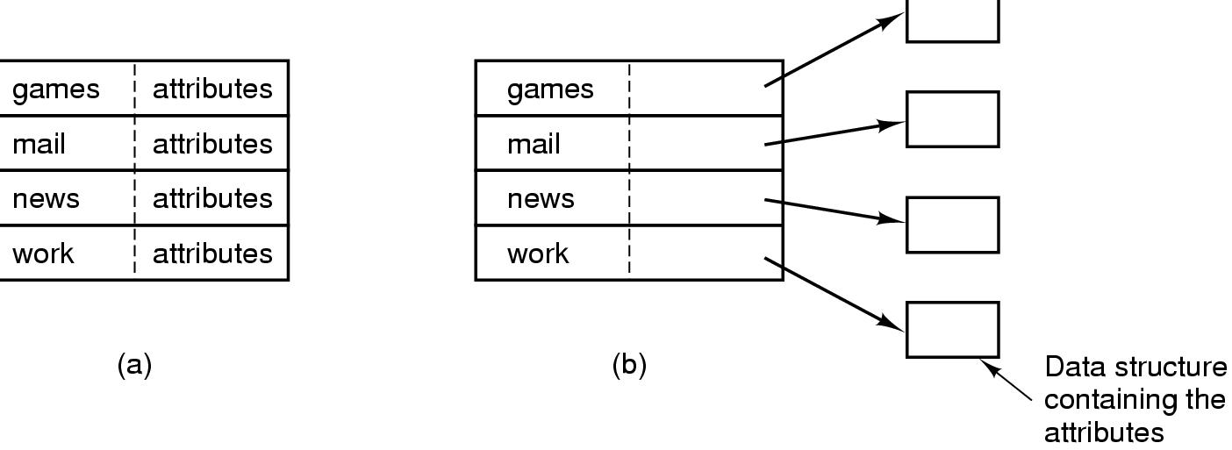
File System Implementation Implementing Directories
Tanenbaum, Fig. 4-14.

Slide 19
File System Implementation Implementing Directories
Long and variable-length file name
First approach (simplest)
Set a limit on file name length, typically 255 characters
Disadvantages: wastes a great deal of directory space
Second approach: All directories entries are same size contains
Starting with the length of the entry
Following with the file attributes
Lasting is actual file name with long it may be (each file name is terminated by special character)
To allow each directory entry begin on word boundary, each file name is filled out to an integral number of words
Disadvantages
When a file is removed, a variable-sized gap is introduced into the directory into which the next file to be entered may not fit → fragmentation
A single directory entry may span multiple pages → page fault occurs when reading a file name

Slide 20
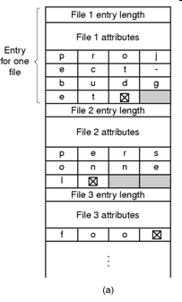
File System Implementation Implementing Directories
Tanenbaum, Fig. 4-15.

Slide 21
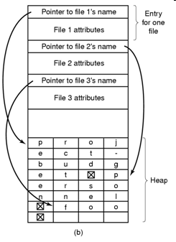
File System Implementation Implementing Directories
Long and variable-length file name (cont)
Third approach (Improvement)
Making the directory entries themselves all fixed length and keep the file names together in a heap at the end of the directory
Advantages
When an entry is removed, the next file entered will always fit there
No filler character after the file name
Tanenbaum, Fig. 4-15.

Slide 22
File System Implementation Implementing Directories
Searching Directories
Search linearly from beginning to end when a file name has to be looked up → slow with extreme long directories
To speed up, the hash table is used
Advantage: faster lookup
Disadvantages: more complex administrator
Applying to the large directories, the searching result is cached
Before starting a search, a check is first made in the cache
If so, it can be located immediately
Otherwise, the searching is started

Slide 23
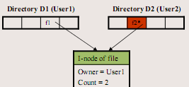
File System Implementation Shared Files
Sharing file is useful in working together on a project
A shared file appear simultaneously in different directories belonging to different users
Problems
The changing of the shared file is listed in the directory of user doing the executing (not visible to other users)
The first solution (traditional/ hard linking)
Disk blocks are not listed in directories, but in a little data structure (i-node) associated with the file itself. The directories would then point just to the little data structure
Advantages
One i-node
No new blocks allocated
Disadvantages:
Can introduce inconsistency
A user can be billed for a “removed file”

Slide 24
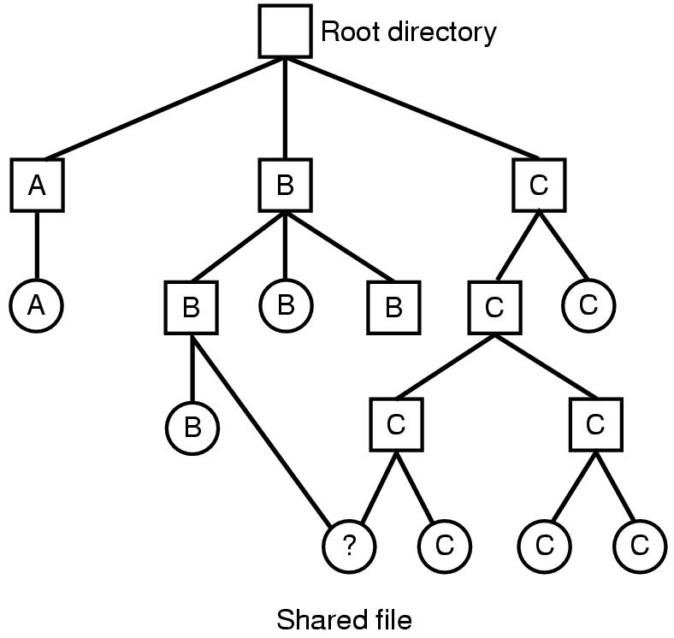
File System Implementation Shared Files
Directed Acyclic Graph - DAG
Tanenbaum, Fig. 4-16.

Slide 25
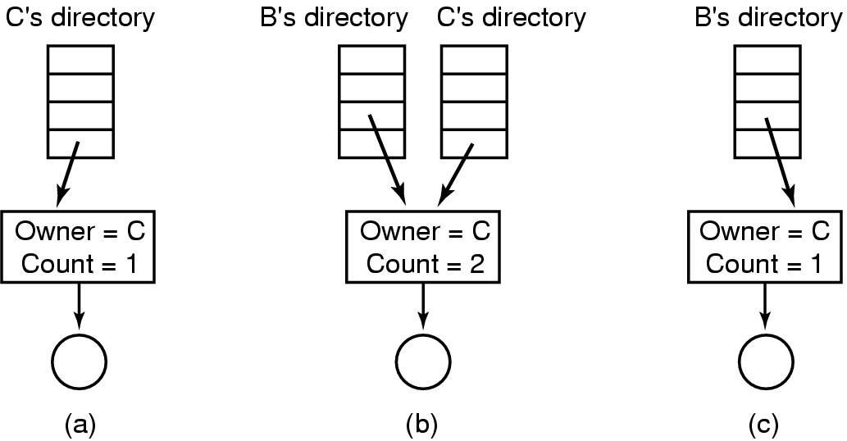
File System Implementation Shared Files
Traditional/ Hard Linking
Tanenbaum, Fig. 4-17.

Slide 26
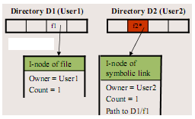
File System Implementation Shared Files
Second solution (symbolic linking)
By having the system create a new file (contains only path name), of type LINK, and entering that file in B’s directory.
When B reads from the linked file, the OS looks up name of the file, and read that file
Advantages:
No inconsistency
Can be used to link to files in a network (only using path name)
Disadvantages:
Extra overhead for getting the file i-node
Extra i-node needed for each symbolic link
Problems
When links are allowed, files can have
two or more paths → execute one more actions

Slide 27
File System Implementation Log-Structured File Systems (LFS)
Problem
In most file system, writes are done is very small chunks (highly inefficient)
In UNIX
To write new file, the i-node for the directory, the directory block, the i-node for the file, and the file itself must all be written
If a crash occurs before the write done, the file system exposes serious consistency problems. Thus, all the writing task can be delayed

Slide 28
File System Implementation Log-Structured File Systems (LFS)
Solutions: using LFS
Structure the entire disk as a log
All writes are initially buffered in memory, and periodically, all the buffered writes to the disk in a single segment at the end of the log
A single segment
Contains i-nodes, directory blocks, and data blocks, all mixed together
At the start of each segment is a segment summary telling what can be found
i-nodes are scattered all over the log (the blocks are located in the usual way when an i-node is located)
Finding i-node is much harder, since its address cannot simply calculated from its i-number.
Thus, an i-node map, indexed by i-number is maintained
Entry i in this map points to i-node i on the disk
The map is kept on disk, but it is also cached → the most heavily used parts will be in memory most of the time
Opening a file consists of using the map to locate the i-node for file. Once the i-node has been located, the addresses of the blocks can be found from it. All of the blocks will themselves be in segments somewhere in the log

Slide 29
File System Implementation Log-Structured File Systems (LFS)
Cache - Buffer
Start Disk
Last Data stored

Slide 30
File System Implementation Log-Structured File Systems (LFS)
Cache - Buffer
Start Disk
Log
Last Data stored

Slide 31
File System Implementation Log-Structured File Systems (LFS)
Cache - Buffer
Start Disk
Log
Last Data stored

Slide 32
File System Implementation Log-Structured File Systems (LFS)
Cache - Buffer
Start Disk
Log
Last Data stored

Slide 33
File System Implementation Log-Structured File Systems (LFS)
Cache - Buffer
Start Disk
Problems
Log
Last Data stored

Slide 34
File System Implementation Log-Structured File Systems (LFS)
Problems
Disks are finitely large, thus when the log occupies the entire disk, no new segments can be written
Many existing segments may have blocks that are no longer need but they still occupy space is previously written segments
Solutions
Cleaner thread spends its time scanning the log circularly to compact it
It starts out by reading the summary of first segment in the log to see which i-nodes and files are there
It then checks the current i-node map to see if the i-nodes are still current and file blocks are still in use → is written in the next segment. Otherwise, that information is discarded
Cleaner moves along the log, removing old segments from the back and putting any live data into memory for rewriting in the next segment
→ the disk is a big circular buffer, with the writer thread adding new segment to the front and the cleaner thread removing old ones from the back
→ complexity (it is a theory)

Slide 35
File System Implementation Journaling File System
Keep a log of what the file system is going to do before it does it
If the system crashes before it can do its planned work
Upon rebooting the system can look in the log to see that was going on at the time of the crash and finish the job
NTFS and Linux ext3 file system applied
Operations required to remove a file in UNIX:
Remove the file from its directory.
Release the i-node to the pool of free i-nodes.
Return all the disk blocks to the pool of free disk blocks.
Problems
The first step is completed and the system crashes
The i-node and file blocks will not be accessible from any file, but will also not be available for reassignment
The second step is completed and the system crashes
Only blocks are lost
If the order of operation is changed
If the i-node is released first, then after rebooting, the i-node may be reassigned, but the old directory entry will continue to point to it, hence to the wrong file
If the blocks are released first, then a crash before i-node is cleared (means the valid directory entry points to an i-node listing blocks now is the free storage pool)

Slide 36
File System Implementation Journaling File System
JFS
First, write a log entry listing the three actions to be completed
Then, the log entry is written to disk
Only after the log entry has been written, do the various operations begin
After complete successfully, the log entry is erased
Therefore, if the system now crashed, upon recovery the file system can check the log to see if any operation were pending → all of them can be rerun until the file is correctly removed
Requirements
The logged operations must be idempotent (they can be repeated as often as necessary without harm)
The crash recovery can be made and secure
Practically, JFS is applied to DB concept with atomic transaction

Slide 37
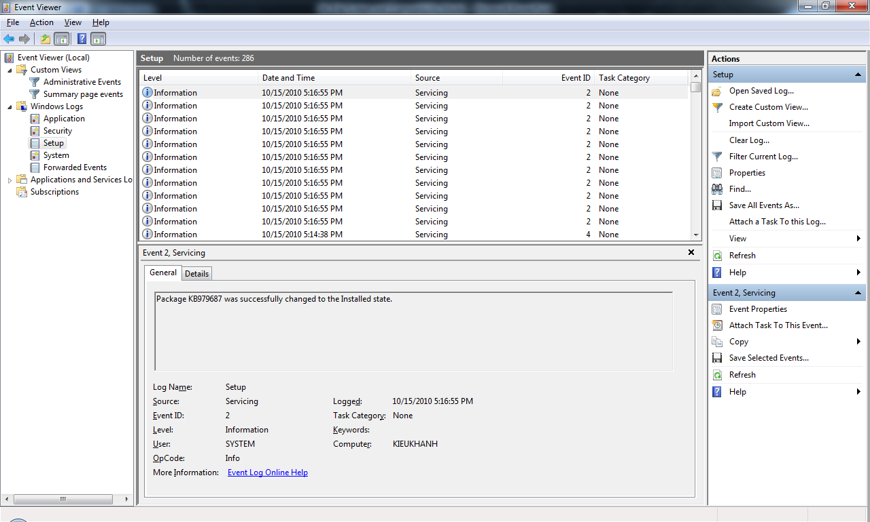
File System Implementation Journaling File System – Example

Slide 38
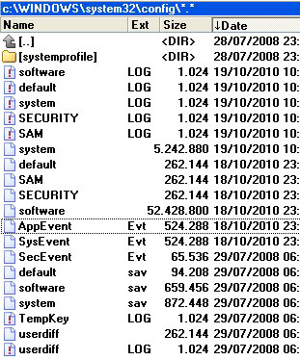
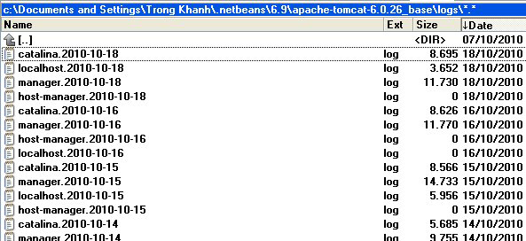
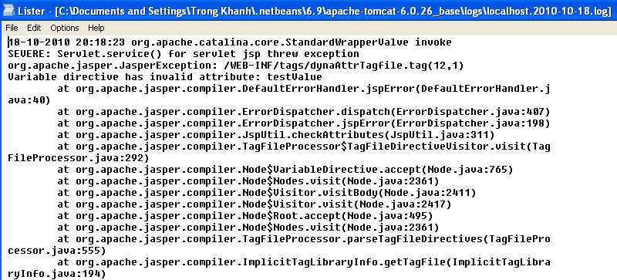
File System Implementation Journaling File System – Example

Slide 39
File System Implementation Virtual File Systems
Problems
Many different file systems are used on the same computer, even same OS
Ex: Windows Vista, XP used NTFS, FAT32, FAT 16
Solution is Virtual File System (Kleiman, 1986 – Sun Microsystems)
Try to integrate multiple file systems into an orderly structure
The key idea is to abstract out that
Part of file system is common to all file system
Put that code in a separate layer that calls the underlying concrete file systems to actual manage the data
The VFS is a upper interface to user processes and the lower interface to concrete file system
All system calls (coming from user processes) relating to files are directed to the VFS for initial processing
Does not know or care where the data are stored or what the underlying file system is like
Is implemented essentially object oriented
Supports key object types as super block, v-node, directory, mount table, an array of file descriptors

Slide 40
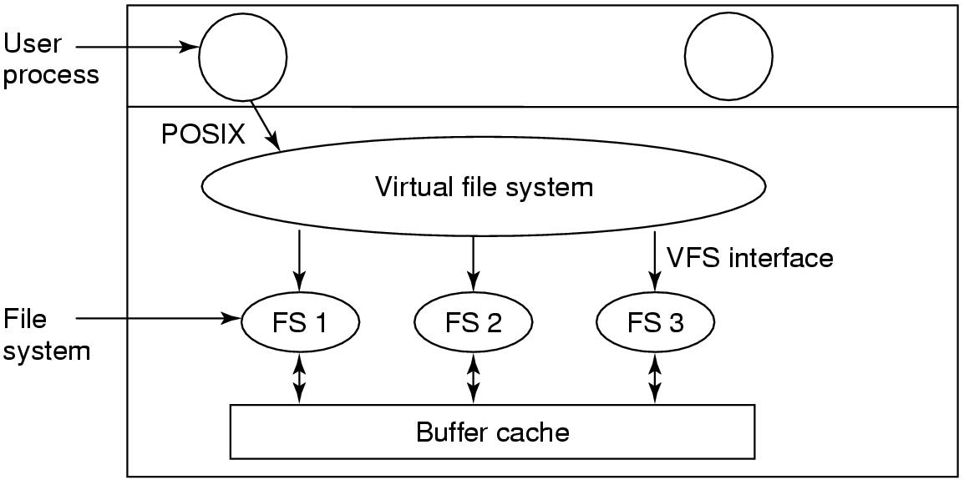
File System Implementation Virtual File Systems
Tanenbaum, Fig. 4-19.

Slide 41
Summary
File System Implementation
Q&A

Slide 42
Next Lecture
File System Management and Optimization
Example File Systems

